Slide 1
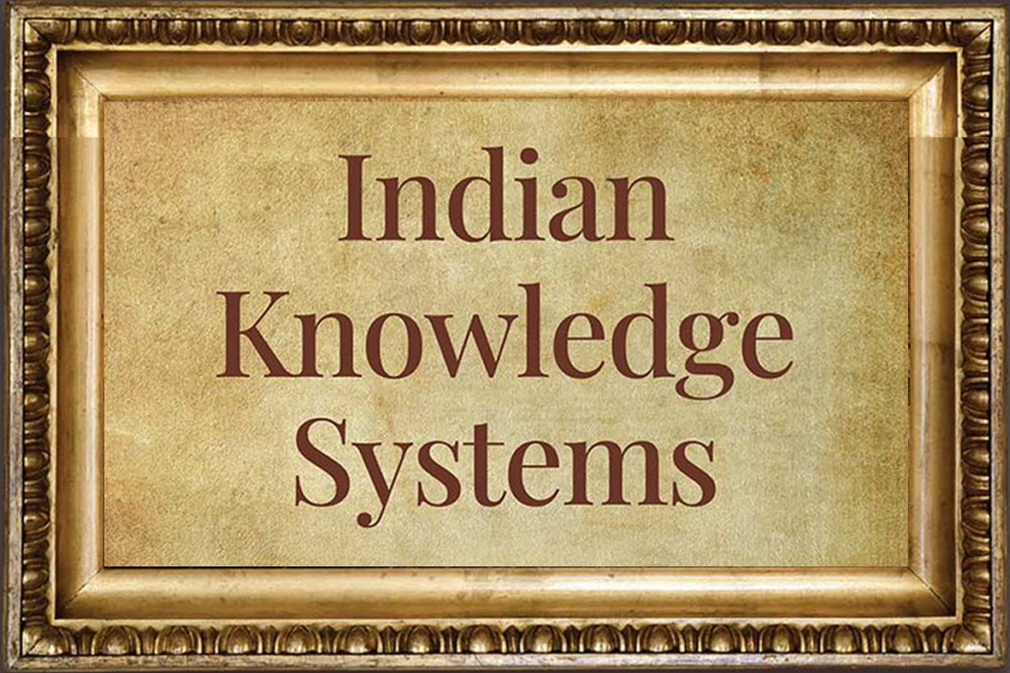
"Indian Knowledge System: A Journey Through Time" Module 5: Women in Indian society

Slide 2
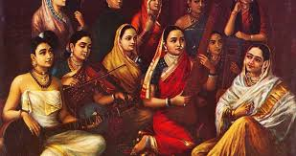
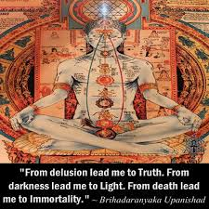
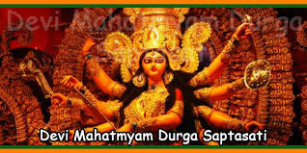
Content
Role and position of women in Hindu civilization; Gleanings from the Vedas
Brihadarnyaka Upanishad
Saptasati Devi Mahatmyam
Ramayana, Mahabharata, Manusmriti ,Kautilya’s Arthasastra and Mrichchhakatikam of Sudraka

Slide 3
Introduction
The role and position of women in Hindu civilization; Gleanings from the Vedas:
Cultural and Historical Insight: The study of women's roles provides a window into the historical, social, and cultural aspects of ancient Hindu civilization. It helps us comprehend the norms, values, and dynamics that shaped the lives of individuals during that time.
Unveiling Gender Dynamics: Exploring women's roles sheds light on the intricate gender dynamics of ancient Hindu society. It allows us to analyze power structures, hierarchies, and the ways in which gender roles were defined and maintained.

Slide 4
Introduction
Influence on Modern Practices: Many aspects of contemporary Hindu traditions and practices have roots in ancient society. Understanding women's roles in the past helps us grasp the origins of certain customs, rituals, and gender-related beliefs that continue to influence modern Hinduism.
Reevaluating Historical Narratives: By delving into women's roles, we can challenge and correct historical narratives that may have been biased or one-sided. It encourages a more nuanced and accurate understanding of the past.

Slide 5
Conti…
Women's Contributions: Ancient Hindu society likely benefited from the contributions of women in various spheres, including religion, education, governance, and culture. Studying these contributions acknowledges and honors the role women played in shaping their communities.
Empowerment and Equality: Analyzing women's roles in ancient times can help us appreciate instances of empowerment and equality that may have existed alongside constraints. It provides a platform for discussions on gender equity and women's rights in historical contexts.

Slide 6
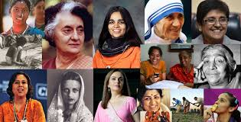
Status of Women in Societies
The status of women in ancient societies varied widely depending on the specific civilization, culture, and time period.
While there were some societies where women enjoyed relatively more rights and opportunities, in many ancient societies, women often faced limitations, restrictions, and unequal treatment.

Slide 7
General overview of the status of women
Ancient Egypt: Ancient Egyptian women had relatively more rights compared to some other ancient societies. Women could own property, engage in trade, and participate in religious rituals. Some women, like Cleopatra, even ruled as pharaohs.
Ancient Greece: In ancient Greece, women had restricted roles and were largely confined to domestic duties. Their participation in public life and politics was minimal. Exceptional cases like Spartan women were known for having more freedom and physical education.
Ancient Rome: Roman women had more legal rights than women in some other ancient societies, including the ability to own property and engage in business. Some women gained prominence in literature and culture. However, their legal status was still subordinate to men.

Slide 8
Conti..
Indus Valley Civilization: While much remains unknown about the Indus Valley Civilization, archaeological evidence suggests that women may have had roles in trade and production. Artifacts like figurines suggest the possibility of a goddess-centered religion.
China: In ancient China, Confucian ideology emphasized the importance of maintaining strict gender roles, where women were expected to be subservient to men and fulfill domestic duties. However, some women in noble families could exert influence behind the scenes.
India: Ancient Indian society, as depicted in texts like the Manusmriti, placed women in a subordinate role to men. However, there were variations within different regions and periods. Women from noble families could have access to education and play roles in religious rituals.

Slide 9
Some key aspects:
Reverence and Respect: The Vedas portray women as worthy of reverence and respect. Goddesses like Sarasvati (goddess of knowledge), Lakshmi (goddess of wealth), and Durga (goddess of strength) are highly revered in Hindu mythology.
Rituals and Vedic Knowledge: Women in ancient times had access to Vedic knowledge and participated in various rituals. Some hymns in the Rigveda were composed by female seers (rishikas), highlighting the role of women in spiritual and intellectual pursuits.
Marriage and Family: Marriage was considered a sacred institution in Vedic society, and women played a vital role as wives and mothers. They were seen as the custodians of family values and played a crucial role in maintaining household harmony.
Social Roles: Women had diverse roles in society, including as educators, artists, and administrators. There were instances of women being appointed as queens and rulers.
Education and Learning: Women were encouraged to pursue education and were well-versed in various branches of knowledge, including medicine, astronomy, and philosophy.

Slide 10
Contemporary Perspectives on Women's Roles in Hindu Society -viewpoints
Empowerment and Equality: There is a growing movement advocating for gender equality and empowerment of women within Hindu society. This perspective emphasizes the need to provide women with equal opportunities in education, careers, and public life. It challenges patriarchal norms and seeks to dismantle barriers that limit women's potential.
Women in Religious Leadership: Contemporary Hinduism is witnessing an increasing number of women taking on leadership roles within religious institutions. Women are becoming priests, scholars, and spiritual leaders, challenging traditional exclusions. This perspective seeks to redefine the boundaries of religious authority and participation.

Slide 11
View Point
Education and Professionalism: Many contemporary Hindu families and communities prioritize education and professional development for women. This perspective recognizes the importance of women's contributions to various fields and encourages their active participation in shaping societal progress.
Legal Reforms and Rights: Advocacy for legal reforms to protect women's rights, including issues related to marriage, divorce, inheritance, and domestic violence, is a significant contemporary perspective. Efforts are being made to align legal frameworks with modern notions of gender equality and justice.

Slide 12
View Point
Globalization and Urbanization: Urbanization and exposure to global perspectives have influenced shifts in attitudes toward women's roles. Urban areas tend to have more diverse and progressive viewpoints, challenging traditional practices that may restrict women's freedoms.
Cultural Preservation: Some contemporary perspectives emphasize the preservation of cultural heritage while also reevaluating and updating certain gender norms. This perspective seeks a balance between honoring tradition and promoting women's rights.
Intersectionality: Contemporary discussions on women's roles in Hindu society also consider intersectionality, recognizing that gender is intertwined with other aspects of identity such as caste, class, religion, and ethnicity. This perspective acknowledges the unique challenges faced by marginalized women and seeks to address their specific needs.

Slide 13
The historical perspectives of women in Hindu civilization can be gleaned from which ancient sacred texts of Hinduism?
a) Puranas
b) Upanishads
c) Vedas
d) Smritis
The role and position of women in Hindu civilization have evolved over time due to various factors, including changes in:
a) Religious practices
b) Socioeconomic conditions
c) Political leadership
d) Climate and geography
In the context of Hindu civilization, which goddess is associated with knowledge, arts, and learning?
a) Lakshmi
b) Parvati
c) Saraswati
d) Durga

Slide 14
Brihadaranyaka Upanishad - Introduction
The Upanishads are a collection of ancient Indian texts that form the core philosophical teachings of Hinduism.
They are considered a continuation and apex of the Vedic literature, which includes the Vedas and various other texts.
The Upanishads are revered as profound spiritual and philosophical writings that delve into the nature of reality, the self, and the ultimate purpose of human existence.

Slide 15
The Brihadaranyaka Upanishad is associated with the Yajur Veda, one of the four Vedas in Hinduism.
Specifically, it is part of the Shukla Yajur Veda, one of the two main branches of the Yajur Veda.
The Brihadaranyaka Upanishad is considered one of the most important Upanishads in the Vedantic tradition and is a foundational text for the study of Vedanta philosophy.

Slide 16
Overview of the Upanishads and their significance
Origin and Nature: The Upanishads were composed in India over a span of several centuries, roughly between 800 BCE and 400 BCE. The word "Upanishad" is derived from Sanskrit words that mean "sitting down near" or "sitting close to," indicating the traditional practice of a student sitting close to a spiritual teacher to receive esoteric knowledge.
Philosophical Content: The Upanishads explore profound philosophical questions, such as the nature of reality (Brahman), the relationship between the individual soul (Atman) and the universal soul (Brahman), the nature of the material and spiritual worlds, and the path to liberation (Moksha) from the cycle of birth and death (Samsara). They are concerned with the exploration of metaphysics, ethics, and the nature of consciousness.

Slide 17
The Brihadaranyaka Upanishad is credited to ancient sage Yajnavalkya, but likely refined by a number of ancient Vedic scholars.
It has six adhyayas (chapters)
It consists of three khandas. The link between the individual and the Universal self is something that the madhu khanda muses on. The argument known as the muni khanda of Yajnavalkya provides the philosophical foundation for the prior instruction. The khila khanda discusses a variety of worship and meditation practices.

Slide 18
Structure and Chapters
The Brihadaranyaka Upanishad is a profound philosophical text that consists of six chapters, often referred to as "Adhyayas."
Each chapter explores different themes and engages in philosophical dialogues, contributing to a comprehensive exploration of fundamental concepts in Hindu philosophy.
Here's a description of the structure and content of each chapter
Madhu Kanda (Chapter 1):
This chapter begins with a story in which a sage named Yajnavalkya divides his property among his two wives, Maitreyi and Katyayani, in preparation for his renunciation.
Maitreyi, Yajnavalkya's first wife, seeks spiritual wisdom and asks her husband about the nature of the self (Atman) and the ultimate reality (Brahman).
Yajnavalkya imparts profound philosophical teachings to Maitreyi, discussing the concept of the self and its relationship with the universe

Slide 19
Structure and Chapters
Chapter 2: Muni Kanda
This chapter continues with Yajnavalkya's teachings, and it is sometimes referred to as the "Yajnavalkya Kanda" due to its focus on his dialogues and discussions.
Yajnavalkya engages in intellectual debates with other sages, exploring various aspects of spiritual knowledge and philosophy.
The teachings in this chapter cover topics like the nature of the self, the senses, and the importance of inner contemplation.

Slide 20
Chapter 3: Khila Kanda
This chapter is referred to as the "supplementary section."
It consists of various miscellaneous teachings and rituals, including ceremonies and sacrifices.
Though it may appear distinct from the philosophical themes of the earlier chapters, it still contributes to the overall understanding of the Upanishad.

Slide 21
The Brihadaranyaka Upanishad is considered a key text in Advaita Vedanta, one of the major philosophical schools of Hinduism that advocates the non-dualistic understanding of reality. It has also been commented upon and interpreted by numerous philosophers and scholars throughout history.
Overall, the Brihadaranyaka Upanishad plays a significant role in shaping the philosophical underpinnings of Hindu thought and continues to inspire seekers on their spiritual journey.

Slide 22
Significance and role of Upanishads
Quest for Ultimate Knowledge: The Upanishads signify the transition from the ritualistic practices of the earlier Vedic period to a more introspective and philosophical approach. They address the fundamental questions about existence, the nature of the universe, and the purpose of human life.
Spiritual Wisdom: Upanishads offer profound spiritual wisdom and insights into the nature of the self (Atman) and its relationship with the supreme reality (Brahman). They explore the concept of eternal truths beyond the material world, emphasizing the eternal nature of the soul and the pursuit of liberation (Moksha) from the cycle of birth and death (Samsara).

Slide 23
Non-Dualistic Philosophy: Many Upanishads explanation Advaita Vedanta, a non-dualistic philosophical school that posits the oneness of the individual soul (Atman) and the cosmic reality (Brahman). This teaching encourages seekers to realize their inherent divinity and transcend the illusion of separateness.
Guru-Disciple Tradition: The Upanishads are often structured as dialogues between respected sages and their earnest disciples. This guru-disciple tradition highlights the importance of oral transmission of spiritual knowledge from teacher to student, ensuring the preservation and continuity of wisdom throughout generations.

Slide 24
Influence on Later Philosophies: The Upanishads profoundly influenced various philosophical systems within Hinduism, such as Vedanta, Yoga, and Samkhya. Their teachings also resonated with Buddhist and Jain philosophies, contributing to the broader spiritual landscape of ancient India.
Vedanta: Vedanta is one of the six orthodox (astika) schools of Hindu philosophy and is based on the Vedas, the oldest sacred texts of Hinduism.
Yoga: Yoga is both a philosophical and practical system that aims to achieve spiritual and physical harmony.
Samkhya: Samkhya is one of the oldest philosophical systems in India and is often considered atheistic or non-theistic.

Slide 25
Relevance in Modern Times: Despite their ancient origins, the Upanishads continue to hold relevance in contemporary spiritual pursuits. Their timeless wisdom provides guidance to individuals seeking deeper meaning in life, fostering spiritual growth, and encouraging a profound understanding of the interconnectedness of all beings.

Slide 26
Q.1 Which Vedic text is the Brihadaranyaka Upanishad associated with?
a) Rigveda
b) Yajurveda
c) Samaveda
d) Atharvaveda
Q.2 How many chapters (adhyayas) are there in the Brihadaranyaka Upanishad?
a) Four chapters
b) Six chapters
c) Eight chapters
d) Ten chapters
Q.3 What is the primary focus of the Upanishads?
a) Rituals and ceremonies
b) Social and political governance
c) Philosophical and spiritual
d) None of the above

Slide 27
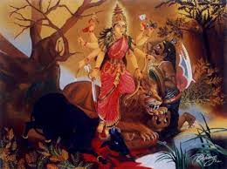
Flow of Content
Saptasati Devi Mahatmyam
The Glory of the Goddess in Seven Hundred Verses

Slide 28
Introduction
Saptasati Devi Mahatmyam, also known as Durga Saptasati or Chandi Path
It is a revered Hindu scripture that praise the glory and power of the goddess Devi.
Comprising 700 verses(shloka), it is found within the Markandeya Purana, one of the ancient texts of Hinduism.
The scripture narrates the epic battles and triumphs of the goddess in her various forms, showcasing her divine prowess in overcoming evil forces and restoring cosmic balance.

Slide 29
Conti…
Saptasati Devi Mahatmyam is widely revered for its spiritual significance and is often recited or chanted during Navaratri, a nine-night festival dedicated to the worship of the goddess. It is believed to bestow blessings, protection, and strength upon the devotees. The scripture's narratives not only celebrate the goddess's valor but also hold illustrative meanings, symbolizing the triumph of good over evil and the spiritual journey of the individual soul.
The scripture's narratives not only celebrate the goddess's valor but also hold illustrative meanings, symbolizing the triumph of good over evil and the spiritual journey of the individual soul.

Slide 30
Historical Context
Saptasati Devi Mahatmyam, while a part of the larger Markandeya Purana, has its origins shrouded in antiquity, making it challenging to pinpoint a specific historical timeline. The Markandeya Purana itself is a complex and multi-layered text that evolved over centuries, encompassing a variety of stories, teachings, and philosophical discussions
The origins of Saptasati Devi Mahatmyam can be traced back to ancient Indian oral traditions, where stories about the goddess Devi were passed down through generations. These stories likely emerged as a way to convey important spiritual and ethical teachings, often using figurative narratives to convey deeper philosophical insights.

Slide 31
Structure of Saptasati Devi Mahatmyam
Saptasati Devi Mahatmyam, as the name suggests, consists of seven hundred verses that are organized into three main sections known as "Charitras.“
Each section tells a distinct story highlighting the power and glory of the goddess Devi.
Prathama Charitra (First Section): This section comprises the first 262 verses and introduces the background and context of the narrative. It primarily tells the story of the demon Mahishasura, who, through his intense penance, gained a boon from Lord Brahma that made him nearly invincible. Armed with this boon, Mahishasura wreaked havoc in the three worlds, threatening the gods and sages. Unable to defeat him, the gods invoke Devi, who emerges as a divine light, symbolizing her imminent arrival. The goddess then engages in a fierce battle with Mahishasura and ultimately slays him, restoring balance and order.

Slide 32
Structure of Saptasati Devi Mahatmyam
Madhyama Charitra (Middle Section): The middle section contains verses 263 to 560 and elaborates on the story of Devi's battle against two formidable demons, Shumbha and Nishumbha. These demons, driven by their arrogance and despotism, seek to conquer the universe. The gods once again invoke Devi, who emerges as a radiant goddess. A fierce battle ensues between Devi and the demons' army. Despite their powerful forces, Devi remains unconquerable. She eventually defeats Shumbha and Nishumbha and establishes the triumph of righteousness and dharma.
Uttama Charitra (Final Section): The last section includes verses 561 to 700 and narrates the exploits of Devi as she confronts a demon named Raktabija. This demon possesses a unique power - every drop of his blood that falls on the ground gives rise to a new Raktabija, making him seemingly indestructible. Devi's battle against Raktabija is fierce, and she manifests her fierce form of Kali to counter his ability. With her clever strategy, Devi manages to annihilate Raktabija and his numerous manifestations, bringing an end to his menace.

Slide 33
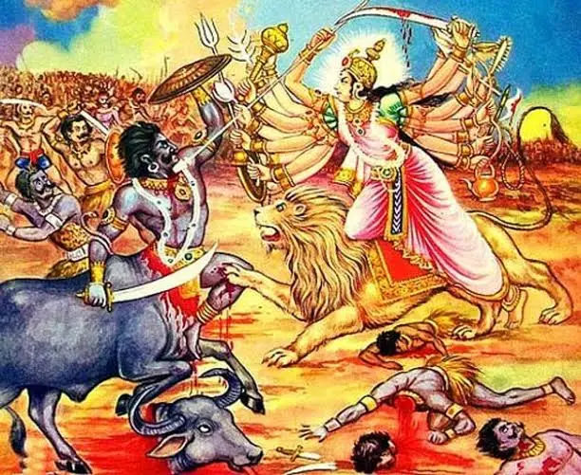
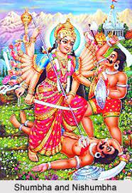
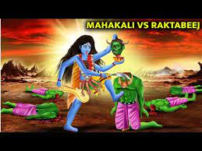

Slide 34
Devi Worship
Devi worship holds profound significance in Hinduism and is deeply ingrained in the spiritual and cultural fabric of the religion. Here are some key aspects that highlight the importance of Devi worship:
Divine Feminine Energy: Devi worship celebrates the divine feminine energy that is believed to be the creative force behind the universe. Devi is often referred to as the Mother Goddess, representing nurturing, compassion, and fertility. Her worship acknowledges the essential role of women in creation, sustenance, and transformation.
Balance and Harmony: Hinduism recognizes the interplay of masculine and feminine energies in the cosmos. Devi worship emphasizes the need for balance and harmony between these energies, fostering a holistic approach to spirituality and life. This balance is vital for the well-being and equilibrium of individuals and the world.

Slide 35
Devi Worship
Empowerment and Equality: Devi worship empowers women and underscores their importance in spiritual practice. Devotees seek inspiration from powerful goddesses who exemplify courage, wisdom, and strength. This serves as a source of empowerment for women and promotes gender equality in a society that has often struggled with patriarchal norms.
Manifestations of the Divine: Devi is believed to manifest in various forms, each representing a specific aspect of divine energy. From the nurturing Durga to the fierce Kali, each form offers devotees a unique perspective on spirituality and enables them to connect with the divine in a way that resonates with their needs and aspirations.
Spiritual Evolution: Devi worship encourages spiritual seekers to recognize the inherent divinity within themselves and others. By meditating on the goddess, devotees can cultivate virtues such as compassion, courage, and humility. Devi worship guides individuals on a path of self-discovery and inner transformation.

Slide 36
Significance of Devi worship
Philosophical Depth: Devi worship encompasses a rich philosophical understanding of the universe. The goddess is often seen as the source of both creation and dissolution, reflecting the cyclical nature of existence. This philosophical dimension encourages contemplation on life, death, and the eternal cycles of birth and rebirth.
In essence, Devi worship embodies the multifaceted nature of divinity and provides a comprehensive framework for spiritual growth, societal harmony, and personal empowerment within the broader context of Hinduism.

Slide 37
Devotion and Spiritual Practice
Saptasati Devi Mahatmyam holds a significant role in Hindu devotional practices and rituals, especially during the auspicious period of Navaratri.
Navaratri Worship
Chandi Homam or Yagna
Regular Recitation
Spiritual Healing and Protection
Group Recitations and Celebrations
Purification and Blessings
Prayer for Specific Desires

Slide 38
Integration into the Indian knowledge system:
Spiritual Text: Saptashati Devi Mahatmyam is revered as a sacred scripture in Hinduism. It is considered one of the major texts within the Indian spiritual tradition, specifically related to the worship of Goddess Durga or Devi, the divine feminine principle.
Hindu Mythology and Puranas: The text is part of the Puranas, which are a genre of ancient Indian literature that comprises mythological narratives, cosmology, genealogies of gods and sages, and discussions on dharma (righteousness). The Devi Mahatmyam narrates the exploits of Goddess Durga, her battles against demons, and her manifestations to protect the universe.
Rituals and Festivals: Saptashati Devi Mahatmyam is recited and worshipped during Navaratri, a significant Hindu festival that celebrates the divine feminine and the victory of good over evil. Devotees chant the verses of the text to invoke the blessings of Goddess Durga and seek protection, prosperity, and spiritual growth

Slide 39
Bhakti Tradition: The text plays a crucial role in the Bhakti (devotional) tradition of Hinduism. It inspires devotees to develop deep love and devotion towards Goddess Durga, encouraging them to surrender to the divine will and seek solace in her grace.
Spiritual Philosophy: The teachings and hymns of Saptashati Devi Mahatmyam convey profound spiritual insights. It explores themes of divine grace, the nature of good and evil, the power of devotion, and the path to spiritual liberation. Scholars and seekers contemplate these verses to understand the deeper aspects of life and the spiritual journey.

Slide 40
Art, Music, and Dance: The stories and verses of Saptashati Devi Mahatmyam have inspired various forms of artistic expression in India. Traditional dance forms like Bharatanatyam and Kuchipudi often include performances based on episodes from the Devi Mahatmyam. Additionally, devotional songs (bhajans) and classical music compositions are dedicated to Goddess Durga, drawing from the text's content.
Cultural Heritage: Saptashati Devi Mahatmyam contributes to India's cultural heritage by being an integral part of religious rituals, festivals, and artistic expressions. It reflects the rich tapestry of Indian spirituality and provides a sense of identity and unity among the people.

Slide 41
Conclusion
In conclusion, Saptasati Devi Mahatmyam's enduring importance in Hindu culture and spirituality lies in its ability to bridge the past and the present, offering a reservoir of wisdom, inspiration, and cultural expression that continues to enrich the lives of individuals, families, and communities worldwide. It serves as a timeless beacon guiding seekers on their spiritual journey while preserving the vibrant tapestry of Hindu traditions.

Slide 42
Saptashati Devi Mahatmyam is a sacred text primarily dedicated to the worship of:
a) Lord Shiva
b) Lord Vishnu
c) Goddess Durga
d) Lord Ganesha
2. Devi Mahatmyam, also known as Chandi Path or Saptashati Devi Mahatmyam, is a part of which ancient Indian literature?
a) Vedas
b) Upanishads
c) Bhagavad Gita
d) Puranas

Slide 43
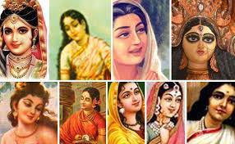
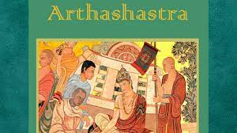
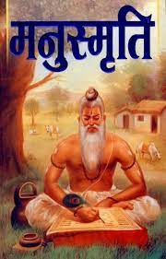
Flow of Content
Ramayana, Mahabharata, Manusmriti ,Kautilya’s Arthasastra and Mrichchhakatikam of Sudraka

Slide 44
Introduction
Significance of Studying Ancient Texts: These ancient texts hold a mirror to the historical perspectives on women's roles and status in Indian society.
Cultural Foundations: Ramayana, Mahabharata, and Manusmriti are foundational to Indian cultural identity and have shaped societal norms for centuries.
Understanding Evolution: By exploring these texts, we gain insight into the evolution of gender roles, societal expectations, and the complexities of women's agency.
Impact on Modern Debates: The insights gathered from these texts continue to influence contemporary discussions on gender equality, women's empowerment, and cultural heritage.
Balancing Tradition and Progress: The study of these texts allows us to navigate the fine line between preserving tradition and fostering progressive values in today's society.

Slide 45
Ancient Perspectives on Women
Ramayana:
An epic narrative attributed to Sage Valmiki.
Chronicles of the life and adventures of Lord Rama, focusing on dharma (duty) and righteousness.
Offers insights into societal norms, familial structures, and the portrayal of women.
Mahabharata:
An epic poem attributed to Sage Vyasa.
Explores the Kurukshetra war and the moral dilemmas faced by its characters.
Provides a multifaceted view of women's roles, ranging from strong and independent to traditional and obedient.

Slide 46
Conti..
Manusmriti:
Also known as the Laws of Manu, attributed to Sage Manu.
An ancient legal and ethical text.
Contains guidelines for social order, including rules and duties for women within the family and society.
Significance:
These texts reflect the social, cultural, and ethical values prevalent during their time.
Offer insights into the roles, expectations, and treatment of women.
Influence the historical and cultural fabric of Indian society, contributing to the shaping of gender norms.

Slide 47
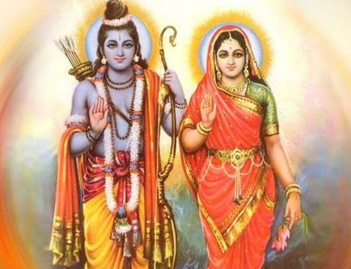
Ramayana - Sita's Character

Slide 48
Ramayana - Sita's Character
Devoted Wife and Daughter:
Sita is introduced as an obedient and devoted daughter of King Janaka.
She undergoes the swayamvara, where Lord Rama wins her hand by lifting Lord Shiva's bow.
Sita's unwavering loyalty and devotion to Rama are evident throughout their journey, including her willingness to accompany him into exile.
Ideal Womanhood:
Sita is often portrayed as the epitome of ideal womanhood.
Her qualities include patience, selflessness, purity, and sacrifice.
Her devotion to Rama, even during hardships, makes her a revered symbol of love and fidelity.
Strength in Adversity:
During her time in captivity by Ravana, Sita's resilience and integrity shine.
She maintains her virtue and dignity despite Ravana's advances, showcasing her inner strength.

Slide 49
Conti…
Testing Times:
Sita undergoes the Agni Pariksha (trial by fire) to prove her chastity upon returning to Ayodhya, facing societal expectations and challenges.
Legacy and Influence:
Sita's portrayal has left an enduring impact on cultural ideals of womanhood in Indian society.
Her character is a source of inspiration for generations, emphasizing qualities like devotion, sacrifice, and loyalty.
Interpretations and Critiques:
Modern interpretations vary; some praise Sita's devotion, while others critique her passivity and the implications of her trials.

Slide 50
Kaikeyi: Kaikeyi, another prominent female character, is one of King Dasharatha's wives and Rama's stepmother. Her actions lead to Rama's exile, highlighting the complexities of familial relationships and the consequences of personal desires.
Surpanakha: Surpanakha is a demoness who falls in love with Rama and Lakshmana, which results in a series of events leading to her disfigurement. Her character exemplifies the consequences of unrequited love and serves as a cautionary tale.

Slide 51
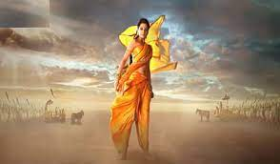
Mahabharata - Draupadi's Role

Slide 52
Mahabharata - Draupadi's Role
Draupadi's Multifaceted Character
Introduction:
Draupadi, a central character in Mahabharata, embodies a range of qualities that make her character multifaceted and intriguing.
Married to Pandavas:
Draupadi's unique marriage to all five Pandava brothers challenges traditional notions of marriage and polyandry.
Her marriage is a result of her mother's misunderstanding of a prophecy.
Disrobing Incident:
One of the most dramatic and pivotal moments in Mahabharata.
Draupadi is publicly humiliated and nearly disrobed in the Kaurava court, sparking the chain of events leading to the Kurukshetra war.

Slide 53
Draupadi: A Complex Character
Strong Personality:
Draupadi exhibits strength through her resilience and determination in the face of adversity.
Her refusal to accept the disrobing shows her refusal to be victimized.
Intellect and Wit:
Draupadi is known for her intelligence and sharp wit, often using her words to navigate complex situations.
She publicly questions societal norms and challenges male authority, showcasing her intellectual prowess.
Courage and Defiance:
Draupadi's courage is evident in her fiery nature and her ability to stand up against injustice. Her determination to seek justice for the wrongs committed against her drives the narrative forward. Draupadi's multifaceted character highlights her strength, intellect, and courage, making her a prominent figure in Mahabharata and a source of inspiration for generations.

Slide 54
Mahabharata - Ambiguous Themes
Introduction:
Mahabharata presents a spectrum of women's roles, reflecting the diverse roles and attitudes prevalent in ancient Indian society.
Kunti:
Kunti, the mother of the Pandavas, navigates challenges while upholding her maternal duties.
Her exceptional devotion to dharma and her role as a mother drive her decisions, even if they lead to personal sacrifices.
Gandhari:
Gandhari, the mother of the Kauravas, is defined by her loyalty to her husband and her role as a mother.
Her decision to blindfold herself symbolizes her commitment to share her husband's blindness, showcasing her devotion.

Slide 55
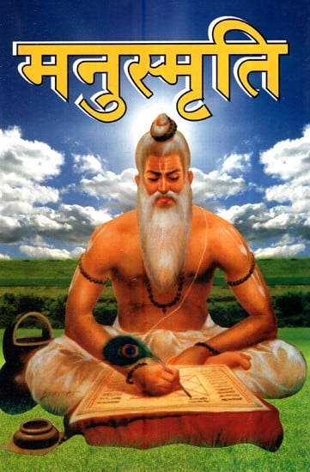
Manusmriti

Slide 56
Manusmriti - Legal and Social Code
Manusmriti Overview:
Manusmriti, also known as the "Laws of Manu," is an ancient Indian legal and social text.
Traditionally attributed to Sage Manu, it is considered one of the earliest works of Dharmashastra (legal and ethical literature).
Time and Context:
Estimated to have been composed between 200 BCE and 200 CE.
Reflects the societal norms, values, and practices of its time.
Structure and Contents:
Comprised of verses organized into chapters, covering various aspects of law, ethics, and social conduct.
Manusmriti addresses family structure, social classes (varnas), duties (dharma), and regulations for individuals and communities.

Slide 57
Conti…
Social Hierarchy:
Manusmriti classifies society into four varnas (castes) based on occupation: Brahmins, Kshatriyas, Vaishyas, and Shudras.
Each varna is assigned specific duties and responsibilities.
Critiques and Interpretations:
Manusmriti has faced criticism for its patriarchal and hierarchical nature, particularly in its treatment of women and lower castes.
Interpretations vary, with some considering it a product of its time and others critiquing its impact on marginalized groups.
Modern Relevance:
Manusmriti's influence can still be seen in cultural and legal practices in India.
The text is often cited in contemporary debates on issues such as gender equality, caste discrimination, and social justice.

Slide 58
Challenging Aspects of Manusmriti
Caste Hierarchy and Discrimination:
Manusmriti's division of society into varnas (castes) has been criticized for institutionalizing social inequality and discrimination.
The text assigns different roles, rights, and privileges based on birth, reinforcing a rigid hierarchy.
Untouchability and Marginalization:
Manusmriti's treatment of lower castes, particularly Shudras and Dalits, has been criticized as promoting segregation and marginalization.
These criticisms reflect concerns about caste-based discrimination that persist in some parts of Indian society.

Slide 59
Conti…
Impact on Contemporary Debates:
The text's patriarchal and hierarchical elements continue to influence discussions on gender equality, caste discrimination, and social justice in India.
Manusmriti is often invoked to challenge or defend traditional practices and norms.
Modern Reinterpretations:
Some scholars seek to reinterpret Manusmriti's teachings in ways that align with modern values of equality and social justice.
These reinterpretations aim to extract progressive lessons while acknowledging its historical context.
Manusmriti's criticism highlights its limitations in reflecting contemporary ideas of equality and justice, prompting ongoing discussions about its relevance and impact.

Slide 60
Impact on Indian Society
Introduction:
Ramayana, Mahabharata, and Manusmriti have played a significant role in shaping attitudes and norms towards women in Indian society over centuries.
Preservation of Traditional Values:
These texts were revered and propagated, leading to the preservation of traditional values, roles, and expectations of women.
Ramayana's Ideal Womanhood:
Sita's portrayal as the epitome of virtue, devotion, and sacrifice has contributed to the perception of the ideal woman.
This depiction has influenced cultural expectations for women's roles within families and marriages.

Slide 61
Shaping Societal Norms and Attitudes
Mahabharata's Complex Representations:
The diverse portrayals of women in Mahabharata have contributed to a nuanced understanding of women's roles and personalities.
Draupadi, Kunti, and Gandhari collectively showcase the range of possibilities for women in different contexts.
Manusmriti's Legal and Social Codes:
Manusmriti's guidelines for women's roles, duties, and status have perpetuated certain norms over time.
Its classification of women as dependent on male relatives has influenced familial dynamics and societal structures.

Slide 62
Long-Term Impact of Ramayana, Mahabharata, and Manusmriti
Sustaining Patriarchal Elements:
Manusmriti's patriarchal tendencies have contributed to the persistence of gender inequalities and imbalances over time.
Fostering Debates and Reinterpretations:
The texts have sparked debates on women's rights, agency, and empowerment.
Efforts to reinterpret these texts through feminist and progressive lenses have challenged traditional norms and sparked dialogue.
Conclusion:
The enduring influence of these texts on societal norms and attitudes towards women highlights their role in both shaping and reflecting cultural values over centuries.

Slide 63
Modern Reinterpretations for Gender Equality and Women's Empowerment
Introduction:
Modern scholars and activists have been engaged in reinterpreting ancient texts like Ramayana, Mahabharata, and Manusmriti to align with the principles of gender equality and women's empowerment.
Feminist Perspectives:
Feminist scholars have examined these texts with a critical lens to challenge traditional gender roles and biases.
They highlight women's agency, challenge stereotypes, and question narratives that reinforce inequality.
Reclaiming Agency:
Efforts to reinterpret Sita's character emphasize her agency and resilience, portraying her as a strong individual rather than a passive victim.

Slide 64
Contemporary Reinterpretations
Manusmriti and Gender Equality:
Modern scholars have attempted to extract principles from Manusmriti that align with contemporary notions of gender equality.
They focus on passages that emphasize respect, consent, and fair treatment of women.
Educational Initiatives:
Educational programs and workshops engage with these texts to promote discussions on gender equality and empowerment.
They encourage critical thinking and help individuals develop nuanced perspectives.

Slide 65
Conti..
Media and Popular Culture:
Contemporary literature, films, and TV shows often reinterpret these characters in ways that resonate with modern audiences and values.
Conclusion:
Modern reinterpretations of these ancient texts provide avenues for fostering discussions on gender equality, challenging stereotypes, and promoting women's empowerment.

Slide 66
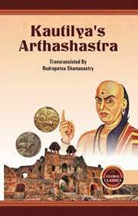
Kautilya’s Arthasastra

Slide 67
Kautilya’s Arthasastra and Mrichchhakatikam of Sudraka
Provides some insights into governance and administration
Kautilya considered women to be faithful, brave and clever besides pleasing.
He detailed very important roles for them in guarding the king, spying on those who posed a risk to the kingdom, in assassinating enemies, and working as secret agents who could stir up strife that weakened opposing states.

Slide 68
Here are some key points:
Women in Administration: The Arthasastra acknowledges that women could be appointed to administrative positions. It mentions the possibility of women serving as spies (female spies were called "veshya-kanyas") who could gather intelligence for the state.
Dynastic Politics: In the context of dynastic politics, the Arthasastra discusses the importance of matrimonial alliances as a means of forming alliances between ruling families. Marriages were seen as strategic tools for maintaining political stability and expanding influence. While this does not directly reflect the empowerment of women, it demonstrates their involvement in matters of political significance.

Slide 69
Protection of Women: The Arthasastra advocates for the protection of women and their rights. It mentions penalties for crimes committed against women, indicating that society recognized the importance of safeguarding women's well-being.
Household Management: Although not explicitly mentioned in the Arthasastra, traditional Indian society assigned women the role of managing households and taking care of family affairs. Women played a crucial role in maintaining the domestic sphere, which was considered essential for the overall well-being of the state.

Slide 70
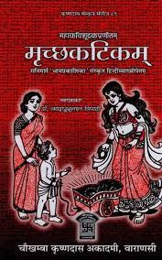
Mrichchhakatikam of Sudraka

Slide 71
Mrichchhakatikam of Sudraka
Mrichchhakatikam, also known as "The Little Clay Cart" is an ancient Indian Sanskrit play written by Sudraka, a playwright who lived during the early centuries of the Common Era.
Mrichchhakatikam, while not explicitly focusing on women's empowerment as its primary theme, does offer some interesting insights into the agency and strength of women in ancient Indian society. The play portrays women who defy societal norms and exhibit their own power and intelligence.

Slide 72
Here are some aspects of women's empowerment that can be observed in Mrichchhakatikam
Vasantasena - Vasantasena, the courtesan, is a central character in the play and exemplifies a woman who exercises her independence and autonomy. Despite her profession, she is depicted as intelligent, resourceful, and compassionate. She makes her own choices and decisions, and her relationship with Charudatta, the protagonist, evolves based on mutual respect and understanding.

Slide 73
Strength in Adversity: The character of Vasantasena faces various challenges and adversities throughout the play. Despite this, she demonstrates resilience and strength of character, handling difficult situations with courage and grace.
Courtesan as a Role Model: Sudraka presents Vasantasena as a strong and independent woman who becomes a role model for others. Her intelligence and wit make her a figure of admiration, not just for the male characters but also for the audience.
Representation of Women's Voices: The play showcases female characters expressing their thoughts, emotions, and desires, which was not a common feature in many ancient literary works. This representation gives a voice to women and their perspectives, even though it confines of the patriarchal society of that time

Slide 74
Summarize the key points
The Ramayana portrays the idealized virtues of women within traditional roles, the Mahabharata offers a more complex and diverse representation of women's strengths and challenges, while the Manusmriti reflects a society with strict hierarchical norms that often limit women's agency and independence. It's important to note that interpretations of these texts can vary, and they need to be understood within their historical and cultural contexts.

Slide 75
Kautilya's Arthasastra and Mrichchhakatikam are invaluable ancient Indian texts that offer unique perspectives on statecraft, governance, society, and human relationships.
While the Arthasastra focuses on principles of administration, economy, and military strategy, Mrichchhakatikam explores social themes, character dynamics, and the agency of women in ancient Indian society.
These texts not only provide historical insights but also continue to be relevant for their portrayal of human behavior and societal complexities.

Slide 76
1. Which Indian woman was the first female Prime Minister of India?
a) Indira Gandhi
b) Mother Teresa
c) Rani Lakshmibai
d) Sarojini Naidu
2. Mrichchhakatikam of Sudraka:
a) It is an ancient Indian treatise on statecraft and governance.
b) The play is set in the ancient city of Ujjayini.
c) The author of the play is Chanakya.
d) It mainly revolves around the economic policies of a kingdom.
3. Which female character in the Mahabharata plays a pivotal role in the Kurukshetra War as the common wife of all five Pandavas?
a) Kunti
b) Gandhari
c) Draupadi
d) Satyavati

Slide 77


